Slide 1
Planar Graphs

Slide 2
Planar Graphs
Consider the next slide. Is it possible to join the three houses to the three utilities in such a way that none of the connections cross?

Slide 3
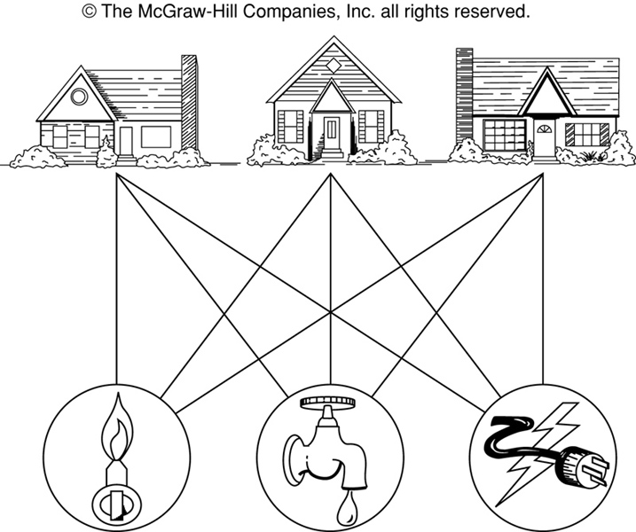
The House-and-Utilities Problem

Slide 4
Planar Graphs
Phrased another way, this question is equivalent to: Given the complete bipartite graph K_{3,3}, can K_{3,3} be drawn in the plane so that no two of its edges cross?
K_{3,3}

Slide 5
Planar Graphs
A graph is called planar if it can be drawn in the plane without any edges crossing.
A graph G is said to be planar if there exists some geometric representation of G which can be drawn on a plane s.t. no two of its edges intersect.
The point of intersection is called crossover.
A graph that can not be drawn on a plane without crossover between its edges called a non-planer graph.
A crossing of edges is the intersection of the lines or arcs representing them at a point other than their common endpoint.
Such a drawing is called a planar representation of the graph.

Slide 6
Example
A graph may be planar even if it is usually drawn with crossings, since it may be possible to draw it in another way without crossings.

Slide 7
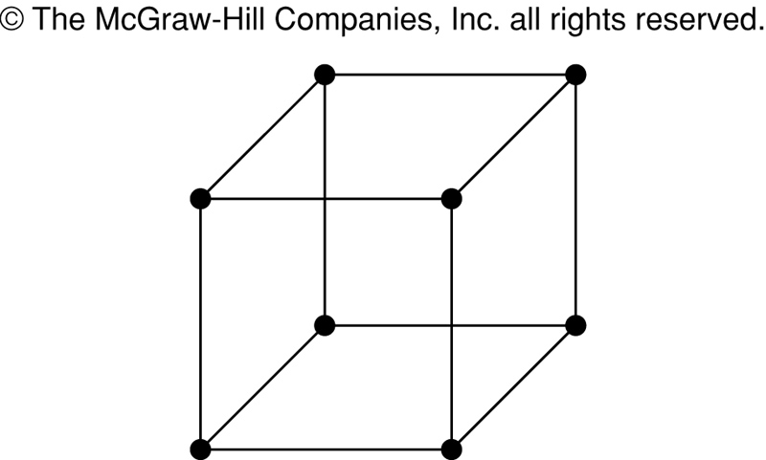
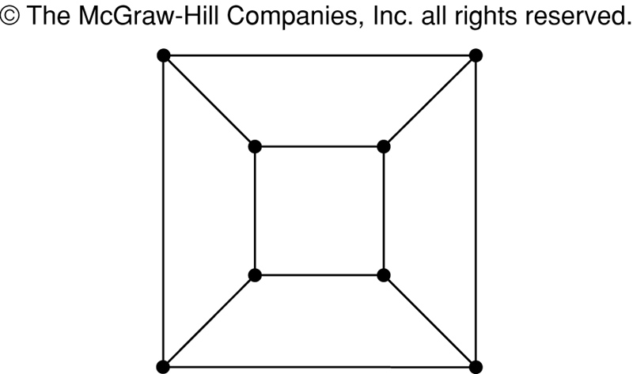
Example
A graph may be planar even if it represents a 3-dimensional object.

Slide 8
Planar Graphs
We can prove that a particular graph is planar by showing how it can be drawn without any crossings.
However, not all graphs are planar.
It may be difficult to show that a graph is nonplanar. We would have to show that there is no way to draw the graph without any edges crossing.

Slide 9
Detection of Planarity of a Graph
Step 1: Since a disconnected graph is a planar if and only if each of its components is planar. We need consider only one component at a time.
Step 2: Since addition or removal of self loops does not affect planarity. Remove all self loops.
Step 3: Since parallel edges do not affect planarity eliminate edges in parallel by removing all but one edge b/w every pair of vertices
Step 4: Eliminate of vertex of degree 2 by merging two edges in series.

Slide 10
Now a connected graph Gi be reduced to a new graph Hi after repeated application of step 3 and 4 so graph Hi is
a) A single edge or
b) A complete graph of four vertices or
c) A simple graph with n>=5 & C>=7. To check planarity e<=3n-6

Slide 11
Euler’s Formula
Let G be a connected planar simple graph with e edges and v vertices. Let r be the number of regions in a planar representation of G. Then r = e - v + 2.
R₄ R₃ R₂
R₁
# of edges, e = 6
# of vertices, v = 4
# of regions, r = e - v + 2 = 4

Slide 12
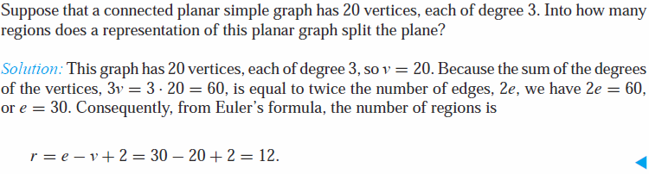
Euler’s Formula Example
r = e - v + 2

Slide 13
Euler’s Formula (Cont.)
r = e - v + 2
Corollary 1: If G is a connected planar simple graph with e edges and v vertices where v ≥ 3, then e ≤ 3v - 6. (no proof)
Is K₅ planar?
K₅

Slide 14
Euler’s Formula (Cont.)
Corollary 1: e ≤ 3v – 6
K₅ has 5 vertices and 10 edges.
We see that v ≥ 3.
So, if K₅ is planar, it must be true that e ≤ 3v – 6.
3v – 6 = 3*5 – 6 = 15 – 6 = 9.
So e must be ≤ 9.
But e = (n choose 2) = n(n-1)/2 = 5*4/2 = 10.
So, K₅ is nonplanar.
K₅

Slide 15
Euler’s Formula (Cont.)
Corollary 2: If G is a connected planar simple graph, then G must have a vertex of degree not exceeding 5.
If G has one or two vertices, it is true;
thus, we assume that G has at least three vertices.
If the degree of each vertex were at least 6, then by Handshaking Theorem,
2e ≥ 6v, i.e., e ≥ 3v,
but this contradicts the inequality from
Corollary 1: e ≤ 3v – 6.

Slide 16
Euler’s Formula (Cont.)
Corollary 3: If a connected planar simple graph has e edges and v vertices with v ≥ 3 and no circuits of length 3, then e ≤ 2v - 4. (no proof)
Is K_{3,3} planar?

Slide 17
Euler’s Formula (Cont.)
K_{3,3} has 6 vertices and 9 edges.
Obviously, v ≥ 3 and there are no circuits of length 3.
If K_{3,3} were planar, then e ≤ 2v – 4 would have to be true.
2v – 4 = 2*6 – 4 = 8
So e must be ≤ 8.
But e = 9.
So K_{3,3} is nonplanar.
K_{3,3}

Slide 18
Homeomorphic Graphs
Two graphs are said to be homeomorphic if one graph can be obtained from the others by creation of edges or merger of edges in series

Slide 19
Regions
Euler showed that all planar representations of a graph split the plane into the same number of regions, including an unbounded region.
R₄ R₃ R₂
R₁

Slide 20
Regions
Euler devised a formula for expressing the relationship between the number of vertices, edges, and regions of a planar graph.
These may help us determine if a graph can be planar or not.

Slide 21
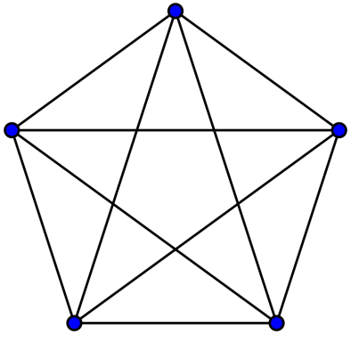
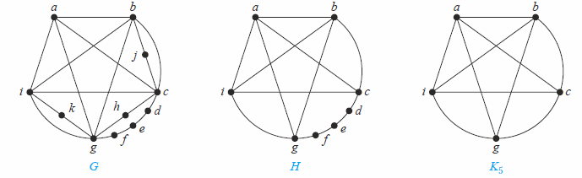
Kuratowski Theorem
A graph is nonplanar if and only if it contains a subgraph homeomorphic to K_{3,3} or K₅.
The intuition: homeomorphism is like graph isomorphism after ignoring some of degree 2 nodes. Example: after ignoring nodes d, e, f in graph H, H is isomorphic to K₅.

Slide 22
Theorem. Graph K_{3,3} is nonplanar.
Proof. In any planar representation of K_{3,3}, vertex v₁ must be connected to both v₄ and v₅, and v₂ also must be connected to both v₄ and v₅.
v₁ v₂ v₃
v₄ v₅ v₆

Slide 23
Regions
The four edges {v₁, v₄}, {v₄, v₂}, {v₂, v₅}, {v₅, v₁} form a closed curve that splits the plane into two regions, R₁ and R₂.
v₁ v₂ v₃
v₄ v₅ v₆
v₁ v₅
R₂ R₁
v₄ v₂

Slide 24
Regions
Next, we note that v₃ must be in either R₁ or R₂.
Assume v₃ is in R₂. Then the edges {v₃, v₄} and {v₄, v₅} separate R₂ into two subregions, R₂₁ and R₂₂.
v₁ v₅ v₁ v₅
R₂₁
R₂ R₁ → v₃
R₂₂
v₄ v₂ v₄ v₂

Slide 25
Regions
Now there is no way to place vertex v₆ without forcing a crossing:
If v₆ is in R₁ then {v₆, v₃} must cross an edge
If v₆ is in R₂₁ then {v₆, v₂} must cross an edge
If v₆ is in R₂₂ then {v₆, v₁} must cross an edge
v₁ v₅
R₂₁
v₃ R₁
R₂₂
v₄ v₂

Slide 26
Regions
Alternatively, assume v₃ is in R₁. Then the edges {v₃, v₄} and {v₄, v₅} separate R₁ into two subregions, R₁₁ and R₁₂.
v₁ v₅
R₁₁
R₂ R₁₂ v₃
v₄ v₂

Slide 27
Regions
Now there is no way to place vertex v₆ without forcing a crossing:
If v₆ is in R₂ then {v₆, v₃} must cross an edge
If v₆ is in R₁₁ then {v₆, v₂} must cross an edge
If v₆ is in R₁₂ then {v₆, v₁} must cross an edge
v₁ v₅
R₁₁
R₂ R₁₂ v₃
v₄ v₂

Slide 28
Planar Graphs
Consequently, the graph K_{3,3} must be nonplanar.
K_{3,3}

